Slide 1

UNIVERSITY OF RWANDA
NAME: NDAGIJIMANA Bernard
REG No:223007117
COLLEGE :CBE
DEPERTMENT:BIT
YEAR: BIT LEVEL 2
ASSIGNMENT OF DSA(Data structure &Algorithm

Slide 2
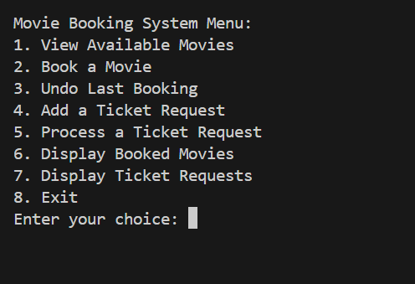
Overview of my project “movie theater booking system”
This is the movie booking system menu if user want to book movies follows this instruction :

Slide 3
UNIVERSITY OF RWANDA
HUYE-CAMPUS
NAME:NDAGIJIMANA BERNARD
REG NO:223007117
ASSIGNMENT: DSA
QUESTIONS: Movie Theater Booking System: Stack for undoing bookings, queue for ticket requests, and list for available movie screenings.
=> PRESENTATION OF MOVIE THEATER BOOKING SYSTEM

Slide 4
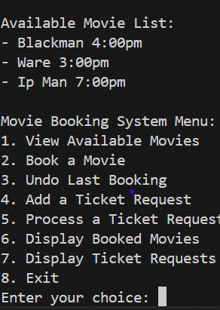
IF USER WANT TO SEE AVAILABLE MOVIE
If the user selects option 1 to view the list of movies, the system will display all the available movies. This allows the user to see what movies are currently available for booking.
If no movies are available, the system will notify the user with a message such as, "No movies are available at the moment."

Slide 5
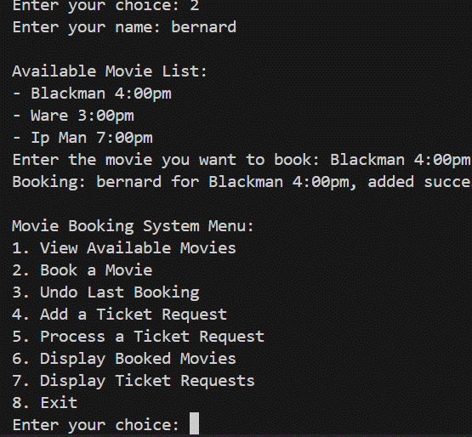
IF USER WANT TO BOOK MOVIE
According to the menu of the movie booking system, if the user selects option 2, the system prompts them to enter their name, displays the list of available movies, and allows them to choose a movie to book. Once the booking is complete, a notification appears on the screen confirming the movie name and the exact time of booking. However, if the user enters a movie that does not exist on the list, the system will display a message stating, "Movie doesn't exist on the movie list."

Slide 6
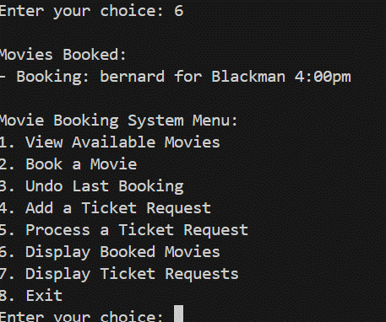
AFTER BOOKING MOVIE
After booking a movie, if the user wants to check their booking, they can select option 6 in the movie booking system. If a movie has been booked, the system will display the details of the booked movie. If no movie has been booked, the system will display a message stating, "There is no movie booked."

Slide 7
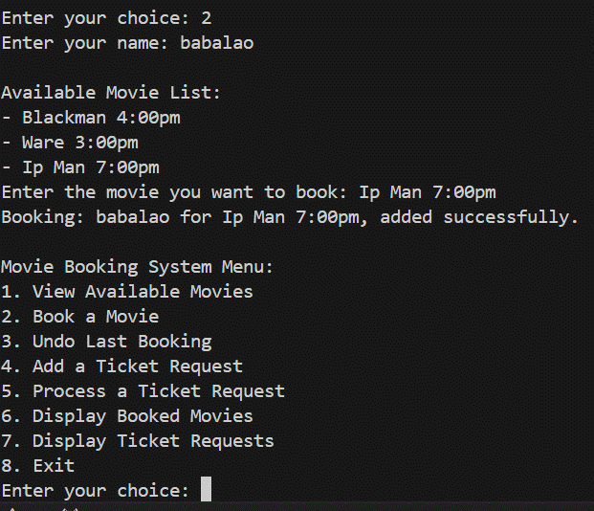
2nd choice of user
When another user books a movie, the system will display the booking details, including the customer's name, the movie booked, and the exact time of booking. Additionally, the system will show a short notification on the screen stating, "The movie has been added successfully."

Slide 8
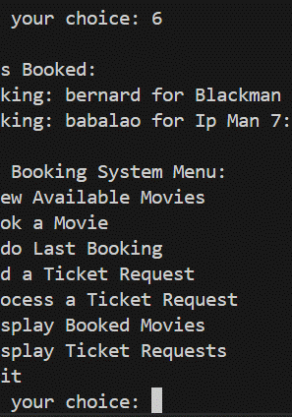
IF USER WANT TO VIEW ALL MOVIE BOOKED
To see all booked movies, the user can select option 6. If movies have been booked, the system will display a list of all booked movie tickets. If no movies have been booked, the system will notify the user with a message stating, "There is no movie booked."

Slide 9
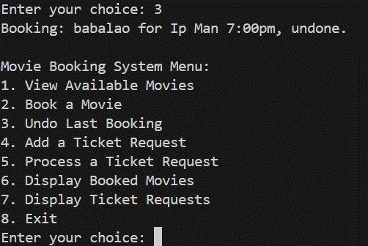
UNDO LAST BOOKING MOVIE
If the user selects option 3, which is Undo Last Booking, the system will perform the following actions:
Check for a Previous Booking:
If there is a last booking, the system will cancel that booking and remove it from the list of booked movies.
A notification will be displayed confirming, "The last booking has been successfully undone.
No Booking to Undo:
If no booking exists to undo, the system will notify the user with a message such as, There is no booking to undo.

Slide 10
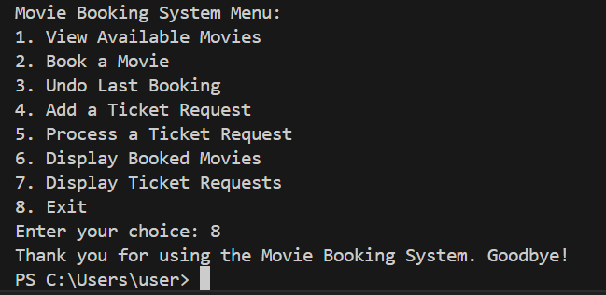
EXIT FROM SYSTEM
When the user selects option 8 to exit, the system will display a message: "Thank you for using the Movie Theater Booking System. Goodbye!" Then, the system will exit.
Exit from system

